Slide 1
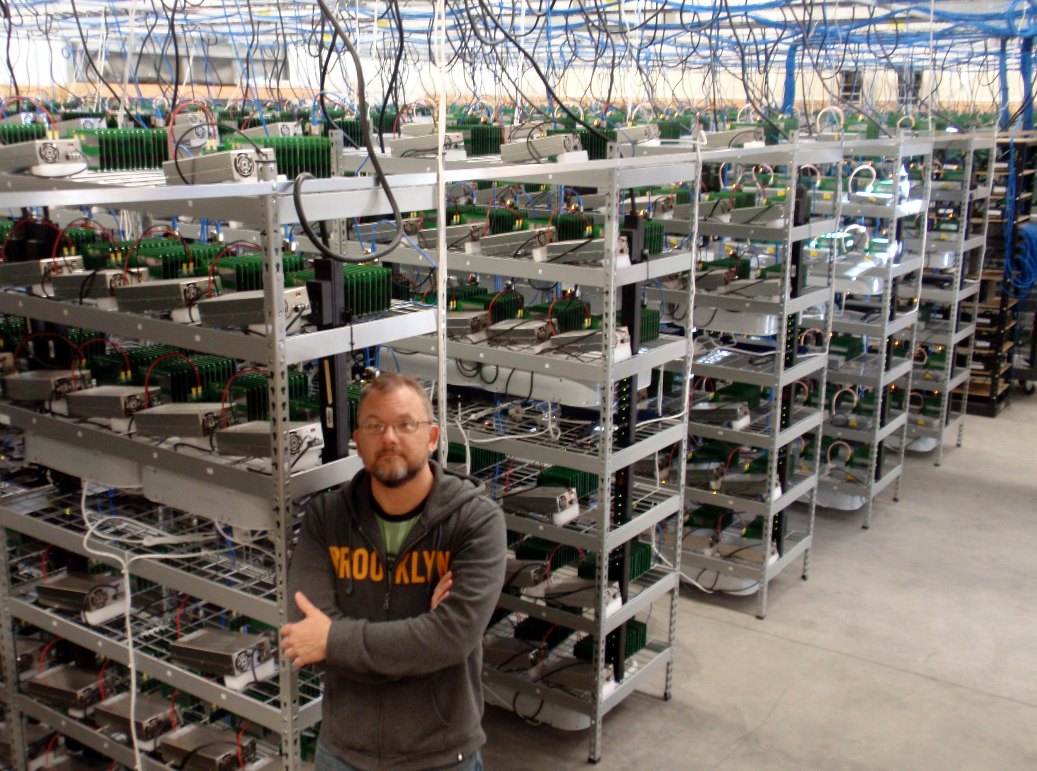
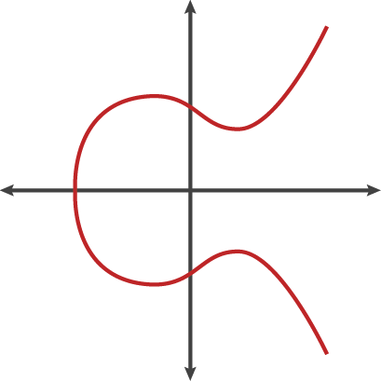
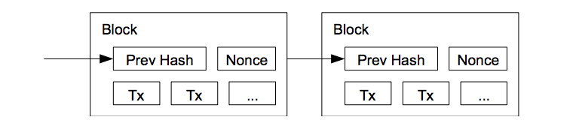
Technical Intro to Bitcoin
Montreal
5F11 78CD D43A 49E9 10D6 D27C 773A E36E 3704 569C
Alex Melville

Slide 2


Alex Melville
Software Engineer @BitGo
World Traveler
github.com/Melvillian/talks

Slide 3
Technical Intro to Bitcoin
Sending a Transaction
Developers
Miners (Secure the Network)
Cryptographic Hash Functions
Addresses
Digital Signatures
Transaction Structure and Signing
Gossip Protocol
Bitcoin Script (if we have time!)

Slide 4
Read the Satoshi Whitepaper!
https://bitcoin.org/bitcoin.pdf
Only 9 pages!

Slide 5
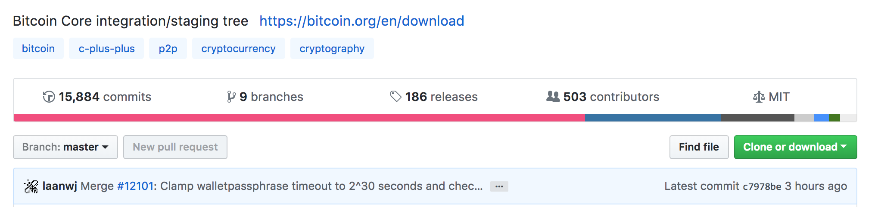
Developers
Bitcoin Core (open source software)
Over 500 unique contributors around the planet
Generates, communicates, and validates blocks and transactions
One of many bitcoin clients (but certainly the most popular!)
Btcd (Golang)
Nbitcoin (.Net)
Bcoin (Javascript)

Slide 6
Sending a Transaction
Need to spend bitcoin you already own
But then… where does the bitcoin you own originally come from?

Slide 7
Mining
Roughly every 10 minutes, 12.5 bitcoin ($125,000) are generated out of nothing
This is the miner’s incentive/reward for securing the network

Slide 8
Mining
Roughly every 10 minutes, 12.5 bitcoin ($125,000) are generated out of nothing
This is the miner’s incentive/reward for securing the network
What does “securing the network” mean?

Slide 9
Mining
Solves 2 problems
How to generate bitcoin without a third party (bank)

Slide 10
Mining
Solves 2 problems
How to generate bitcoin without a third party (bank)
How to prevent double spend attack
Mallory
Alice
Bob

Slide 11
Mining
Solves 2 problems
How to generate bitcoin without a third party (bank)
How to prevent double spend attack
Mallory
Alice
Bob

Slide 12
Mining
Solves 2 problems
How to generate bitcoin without a third party (bank)
How to prevent double spend attack
Mallory
Alice
Bob

Slide 13
Mining
Solves 2 problems
How to generate bitcoin without a third party (bank)
How to prevent double spend attack
Mallory
Neat!
Alice
Bob

Slide 14
Mining
So what does mining actually involve?

Slide 15
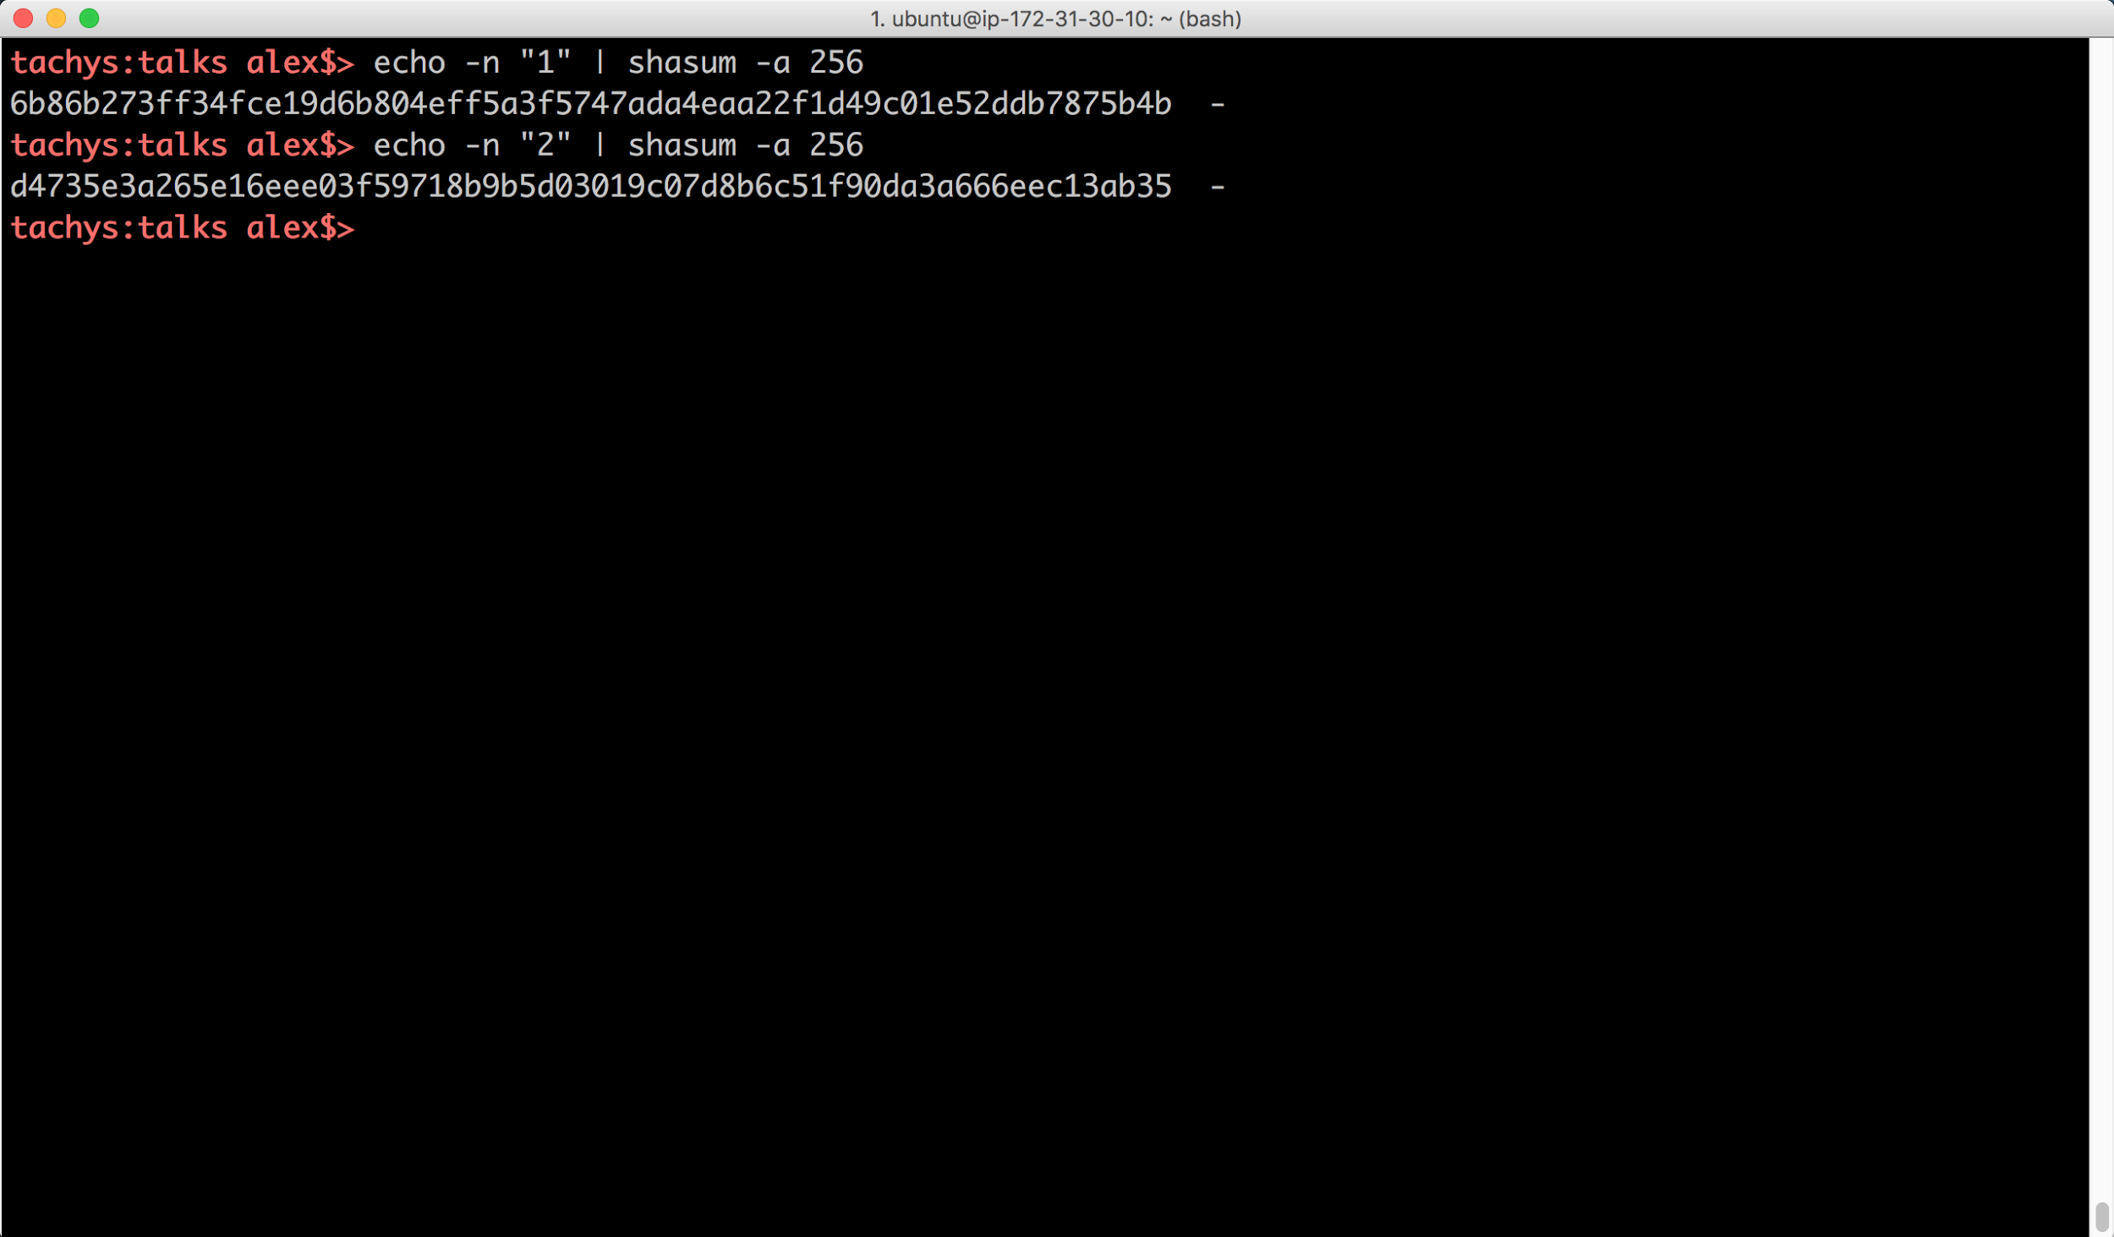
Cryptographic Hash Functions
“Hash” as in Hashmap (with keys)
Given some input data, map it to a random output data
Even a single bit difference will change roughly half of the bits in the output data
Given a hash, you should not be able to guess the data that hashed to it

Slide 16
Mining
The random nature means mining is a random process, and the target value tunes how long it takes to mine a block
SHA256(SHA256(Block Data + nonce)) = 0000000000000000005b5691dbe96364074f0e066631e1f8ae45e84ae495a89b (Bitcoin block from today, January 17th, 11:25am EST)

Slide 17
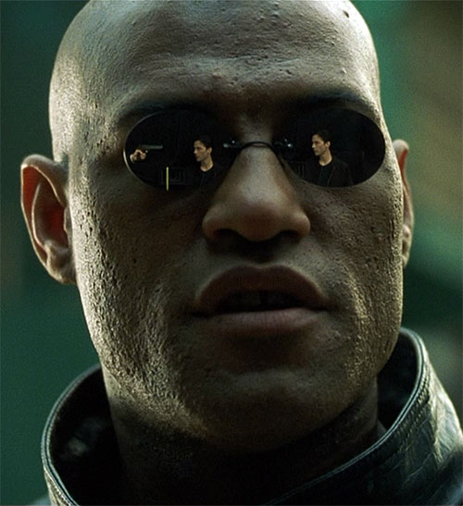
Mining: “There are fields Neo, endless fields…”

Slide 18
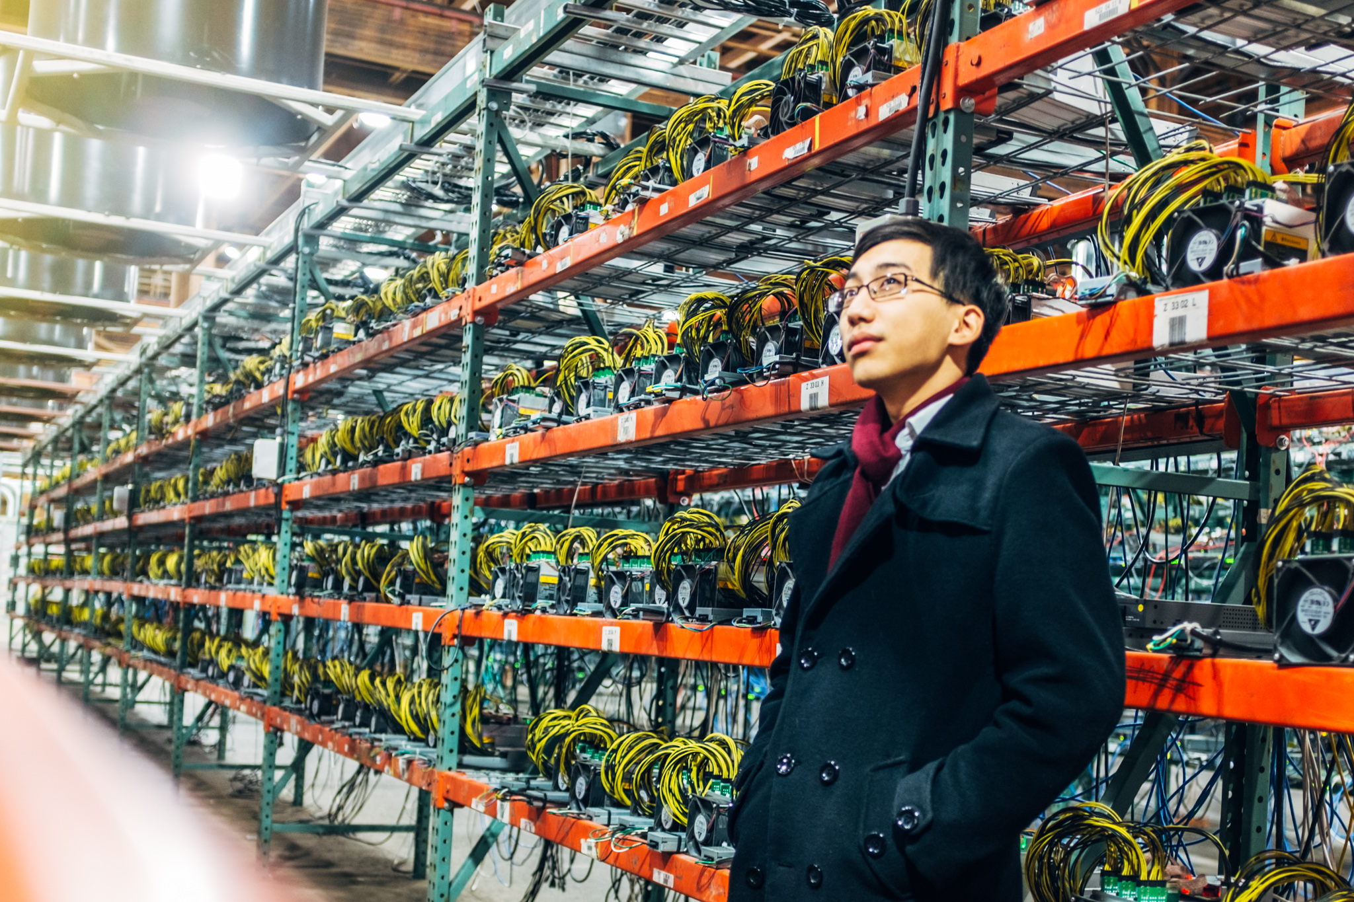
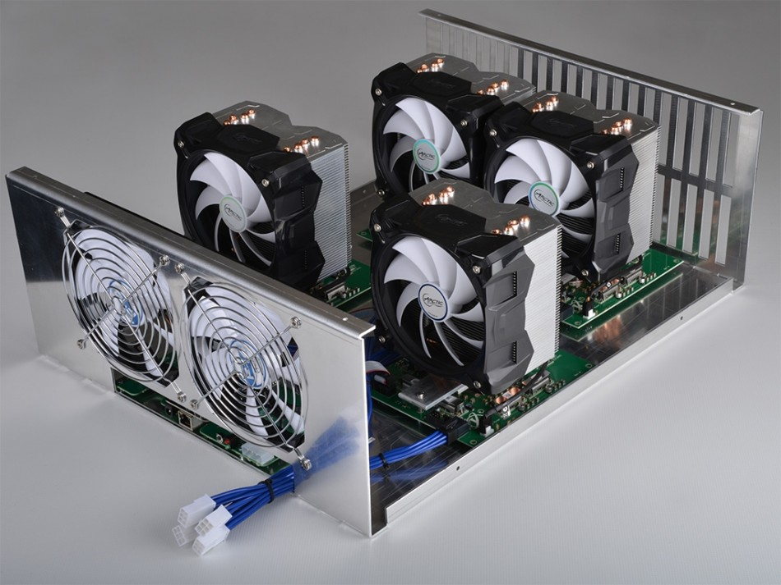
Mining: “There are fields Neo, endless fields…”

Slide 19
Sending a Transaction
OK, we’ve now got our own coin
How do we send it to someone?

Slide 20
Addresses
Long strings of alphanumeric characters with different versions
1D3mnTriicrjdcKhucHm6CAfqy7gNfGcyt (P2PKH)
3JN9RvhN9TMM4q1Hx6Zta3vvBP9Ps5AmFo (P2SH)

Slide 21
Addresses
Long strings of alphanumeric characters with different versions
1D3mnTriicrjdcKhucHm6CAfqy7gNfGcyt (P2PKH)
3JN9RvhN9TMM4q1Hx6Zta3vvBP9Ps5AmFo (P2SH)
Generated from a public/private ECDSA key pair
xpub661MyMwAqRbcFtXgS5sYJABqqG9YLmC4Q1Rdap9gSE8NqtwybGhePY2gZ29ESFjqJoCu1Rupje8YtGqsefD265TMg7usUDFdp6W1EGMcet8
xprv9s21ZrQH143K3QTDL4LXw2F7HEK3wJUD2nW2nRk4stbPy6cq3jPPqjiChkVvvNKmPGJxWUtg6LnF5kejMRNNU3TGtRBeJgk33yuGBxrMPHi
Like email addresses, but cryptographic!

Slide 22
What is a Digital Signature?
-----BEGIN PGP SIGNATURE-----
Version: GnuPG v1
iJwEAQEKAAYFAlRGkIcACgkQU805K63BbbvgkQP/cJktaCbNQtxCfV/ZXIiwn6Mv
tVELtCdcF/JWKD/1BPGaKXT6BiVa6vrB6dOwRWqUGiZbV1VWkj/LglaMqPa1ZEnZ
Bwpux8hyUYRNbjnyVSDYCyyBH/qvhE/9wGgeLRJ5eK/Na6QoKw4XDAo2RHoiBF3o
wwm6vk4PZF8DacCv64o=
=SadA
-----END PGP SIGNATURE-----
Like a handwritten signature, allows you to attest to a piece of data
Cheques
Contracts
Looks like:

Slide 23
What is a Digital Signature?
Like a handwritten signature, allows you to attest to a piece of data
Cheques
Contracts
Looks like:
Bitcoin uses Elliptic Curves to generate secure public private keys
xpub661MyMwAqRbcFtXgS5sYJABqqG9YLmC4Q1Rdap9gSE8NqtwybGhePY2gZ29ESFjqJoCu1Rupje8YtGqsefD265TMg7usUDFdp6W1EGMcet8
xprv9s21ZrQH143K3QTDL4LXw2F7HEK3wJUD2nW2nRk4stbPy6cq3jPPqjiChkVvvNKmPGJxWUtg6LnF5kejMRNNU3TGtRBeJgk33yuGBxrMPHi
Public keys are used to validate the digital signatures on every transaction

Slide 24
Alice & Bob
Alice
Bob

Slide 25
Alice wants to send an invoice to Bob
Pay rent to account
#79BE667E

Slide 26
OK!

Slide 27
Malicious Mallory
Mallory

Slide 29
Mallory replace Alice’s message with her own

Slide 30
Mallory replace Alice’s message with her own
Pay rent to account
#CE870B07

Slide 31
Sure thing Alice!
hehe

Slide 32
Public Private Key Cryptography
Alice
Bob
Public Key
Private Key

Slide 33
Public Private Key Cryptography
Alice
Bob

Slide 34
Public Private Key Cryptography
Alice
-----BEGIN PGP SIGNATURE-----
Version: GnuPG v1
iJwEAQEKAAYFAlRGkH…..gHFLn+Lw1x6LUroOjkl2zjpoCB
6pmQPd09MglBXJfnrBI=
=ET9V
-----END PGP SIGNATURE-----
+
=

Slide 35
Use the public key to verify the message
Bob
-----BEGIN PGP SIGNATURE-----
Version: GnuPG v1
iJwEAQEKAAYFAlRGkH…..gHFLn+Lw1x6LUroOjkl2zjpoCB
6pmQPd09MglBXJfnrBI=
=ET9V
-----END PGP SIGNATURE-----
+
=

Slide 36
Different public key *will not* verify the message
Bob
-----BEGIN PGP PUBLIC KEY BLOCK----- Version: 2.6.i mQCNAi+UeBsAAAEEAMP0kXU75GQdzwwlMiw….kYboAFx xHg43Cnj60OeZG2PKp/kU91ipOJP1cs8/xYOGkeoAMqDfwPeFlkBiA== =ddBN -----END PGP PUBLIC KEY BLOCK-----
+
=

Slide 37
Different public key *will not* verify the message
Bob
-----BEGIN PGP SIGNATURE-----
Version: GnuPG v1
iJwEAQEKAAYFAlRGkH…..gHFLn+Lw1x6LUroOjkl2zjpoCB
6pmQPd09MglBXJfnrBI=
=ET9V
-----END PGP SIGNATURE-----
+
=

Slide 38
Sending a Transaction
OK, we’ve now got our own coin
And we’ve got an address (1D3mnTriicrjdcKhucHm6CAfqy7gNfGcyt)

Slide 39
Sending a Transaction
OK, we’ve now got our own coin
And we’ve got an address (1D3mnTriicrjdcKhucHm6CAfqy7gNfGcyt)
What does a valid transaction actually look like?

Slide 40
Valid Transaction Structure
Transaction Hash (ID)
0fecf9c3b408f87d5fce986e06c78215ea0e1d869568e5517c789174c3a997dd
Version (4 bytes, usually equal to 1)
List of Inputs (coins you’re spending from previous transactions)
List of Outputs (receiving address + amount)

Slide 41
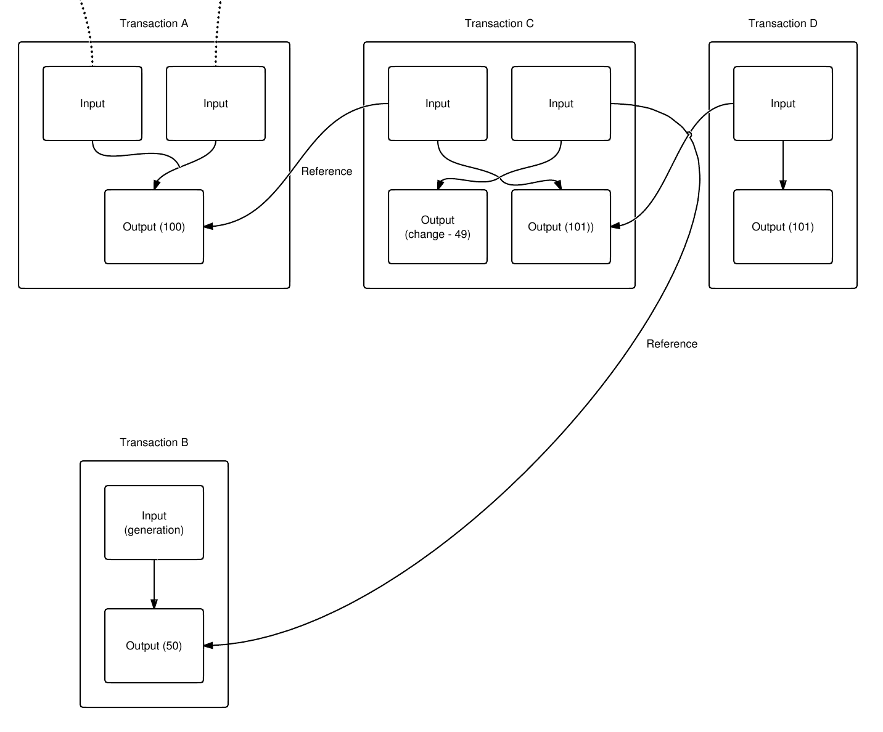
Inputs
Kind of like buying something with different coins from your wallet
Each input references the output from a previous transaction
Contains a signature corresponding to the previous output’s public key
Can be multiple inputs per transaction

Slide 42
Outputs
Much simpler than inputs, simply contains the address to send to, and the amount to send (in satoshis, 1e8 satoshis in 1 BTC
There can be multiple outputs per transactions (batched transactions)
Address: 1D3mnTriicrjdcKhucHm6CAfqy7gNfGcyt
Amount: 10,000,000 satoshi

Slide 43
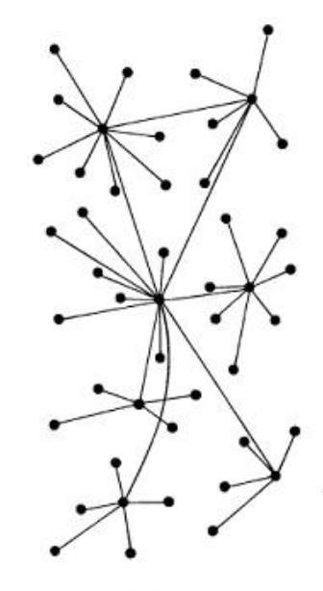
Transaction Broadcasting (Gossip Protocol)
1st Broadcast

Slide 44
Transaction Broadcasting (Gossip Protocol)
2nd Broadcast

Slide 45
Transaction Broadcasting (Gossip Protocol)
3rd Broadcast

Slide 46
Transaction Broadcasting (Gossip Protocol)
4th Broadcast

Slide 47
Confirmed Transaction (we’re done!)
Block #2
Block #1
TX#1: 5b2...a9d
TX#2: 0fecf9c3b408f87d5fce986e06c78215ea0e1d869568e5517c789174c3a997dd
TX#N: 578...5c0
....

Slide 48
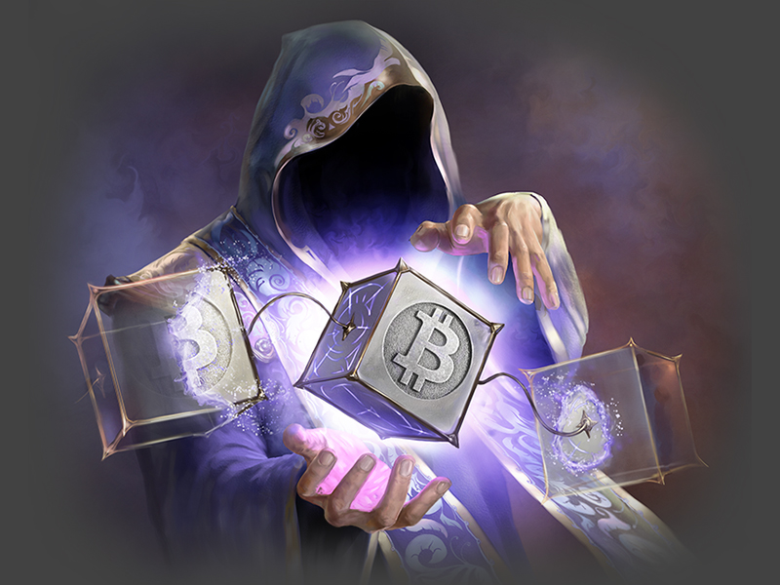
Thanks! Questions?

